Slide 1
Thank you for accepting the offer to submit your ePoster.​
​
This guide provides some hints and tips about designing your poster in terms of structure and graphic design.​
​
There are also some rules, please ensure you use this PowerPoint template and read through the tips in this slide deck.
The ePoster example design can be found on slide 7.

Slide 2
THE RULES
You must submit your ePoster using this template we’ve made available for you to download as a .pptx file.​
Video clips may be used. They should be embedded (not linked) and set to play automatically and loop continuously.
Animations (text builds etc.) can also be used. We advise using them sparingly. They will need to be set to transition at timed intervals.​
Sound is not supported. ​
Our hints and tips are just that, and ultimately, it is up to you. You should not feel constrained by the following design guidelines.

Slide 3


An effective poster is
1
2
3
FOCUSED
GRAPHIC
ORDERED
Focus on your major findings. A common fault is to try to cover too much.
Let graphs and images tell the story. Use text sparingly.
Keep the sequence well-ordered and obvious.

Slide 4
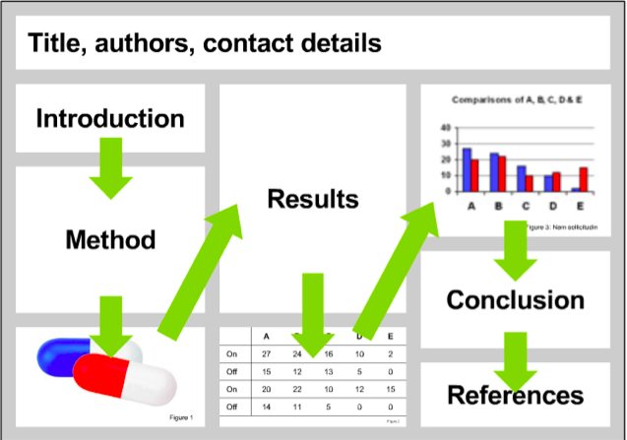
Start by designing your layout
Anyone viewing your poster should be able to easily understand the sequence of information

Slide 5
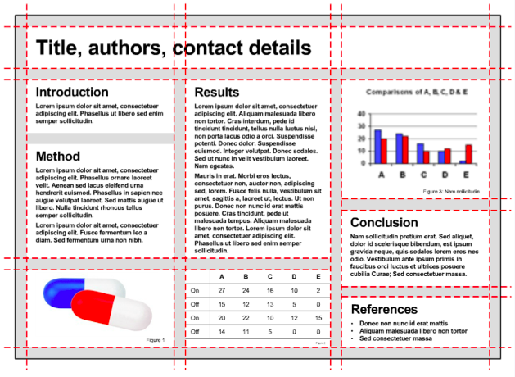
Layout Design
The example shown here shows the sequence clearly, because it has been organised into a grid.
To enable gridlines navigate to the view tab in the ribbon and check the Guides box.

Slide 6

Tips on Design
Choose one font and stick to it. Using a range of different fonts will make your poster difficult to read.
Choose an easy-to-read font.
Use underlining and italics sparingly.
Light coloured text on a dark background will be easier to read on a monitor.
Remember that those reading your poster will be viewing them on a screen. Once you’ve built yours, check how it reads on an electronic device.
This is harder to read than the adjacent example.
This is easier to read than the adjacent example.
This font is harder to read than the adjacent example.
This font is easier to read than the adjacent example.
This is almost impossible to read.
This is almost impossible to miss.

Slide 7

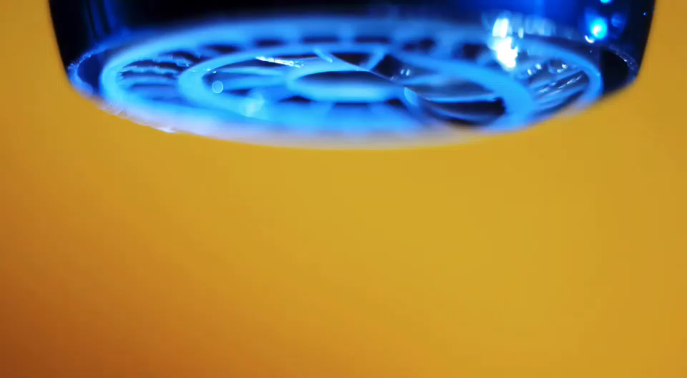
ePoster Title
Authors and Contact details
Background
Results
At vero eos et accusamus et iusto odio dignissimos ducimus qui blanditiis praesentium voluptatum deleniti atque corrupti quos dolores et quas molestias excepturi sint occaecati cupiditate non provident, similique sunt in.
At vero eos et accusamus et iusto odio dignissimos ducimus qui blanditiis praesentium voluptatum deleniti atque corrupti quos dolores et quas molestias excepturi sint occaecati cupiditate non fuga. Et harum quidem rerum facilis est et expedita distinctio. Nam libero temp. At vero eos et accusamus et iusto odio dignissimos ducimus qui blanditiis praesentium. ducimus qui blanditiis praesentium voluptatum deleniti atque corrupti quos dolores et quas molestias excepturi sint occaecati cupiditate non provident, similique sunt in culpa qui official.
Nam libero temp. At vero eos et accusamus et iusto odio dignissimos ducimus qui blanditiis praesentium. ducimus qui blanditiis praesentium voluptatum deleniti atque.
Method
At vero eos et accusamus et iusto odio dignissimos ducimus qui blanditiis praesentium voluptatum deleniti atque corrupti quos dolores et quas molestias excepturi sint occaecati cupiditate non provident, similique sunt in culpa qui officia deserunt mollitia animi, id est laborum et dolorum fuga. Et harum quidem rerum facilis est et expedita distinctio. Nam libero tempore, harum quidem rerum facilis est et expedita distinctio. Nam libero tempore ​
Conclusion
References
At vero eos et accusamus et iusto odio dignissimos ducimus qui blanditiis praesentium voluptatum deleniti atque corrupti quos dolores et quas molestias excepturi sint occaecati cupiditate non ​ blanditiis praesentium voluptatum deleniti atque corrupti quos dolores et quas molestias excepturi sint occaecati cupiditate non fuga​
At vero eos et accusamus et iusto odio dignissimos ducimus
Quos dolores et quas molestias excepturi sint occaecati cupiditate non fuga​
Atque corrupti quos dolores et quas molestias

